Slide 1
Energy Union: an integrated approach to R&I
András Siegler
Director – Energy Directorate
DG RTD, European Commission

Slide 2
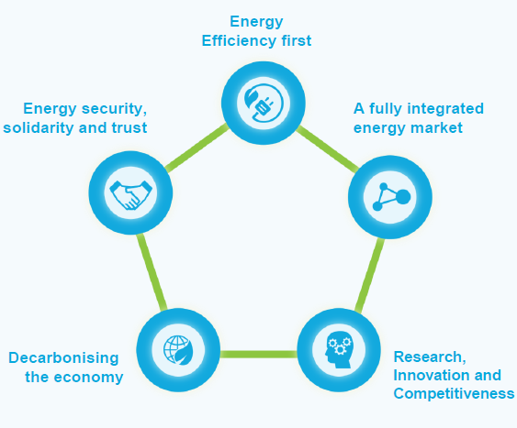
SMART AND CLEAN ENERGY FOR ALL – IMPLEMENTING THE ENERGY UNION STRATEGY
AN ENERGY UNION BASED ON 5 MUTUALLY SUPPORTIVE AND INTERLINKED DIMENSIONS

Slide 3
Accelerating Clean Energy Innovation
Implementing the Paris Agreement in support of jobs, growth and investment in Europe
Research and innovation as drivers for:
Energy efficiency first
Europe as a global leader in renewables
A fair deal for consumers

Slide 4
Policy levers:
Supporting clean-energy research and innovation through three main policy levers:
Policies and regulation: Setting strong and consistent incentives
Crowding in private investment: Alleviating risks in untested technologies and solutions
Public R&I funding: Pushing the frontiers of science and innovation

Slide 5
R&I priorities:
Integrating smart, cutting-edge digital technologies into all aspects of the energy system
1. Decarbonising Europe's building stock
2. Strengthening the EU's leadership in renewables
3. Developing integrated and affordable energy storage solutions
4. Accelerating electro-mobility and the move to a more integrated urban transport system

Slide 6
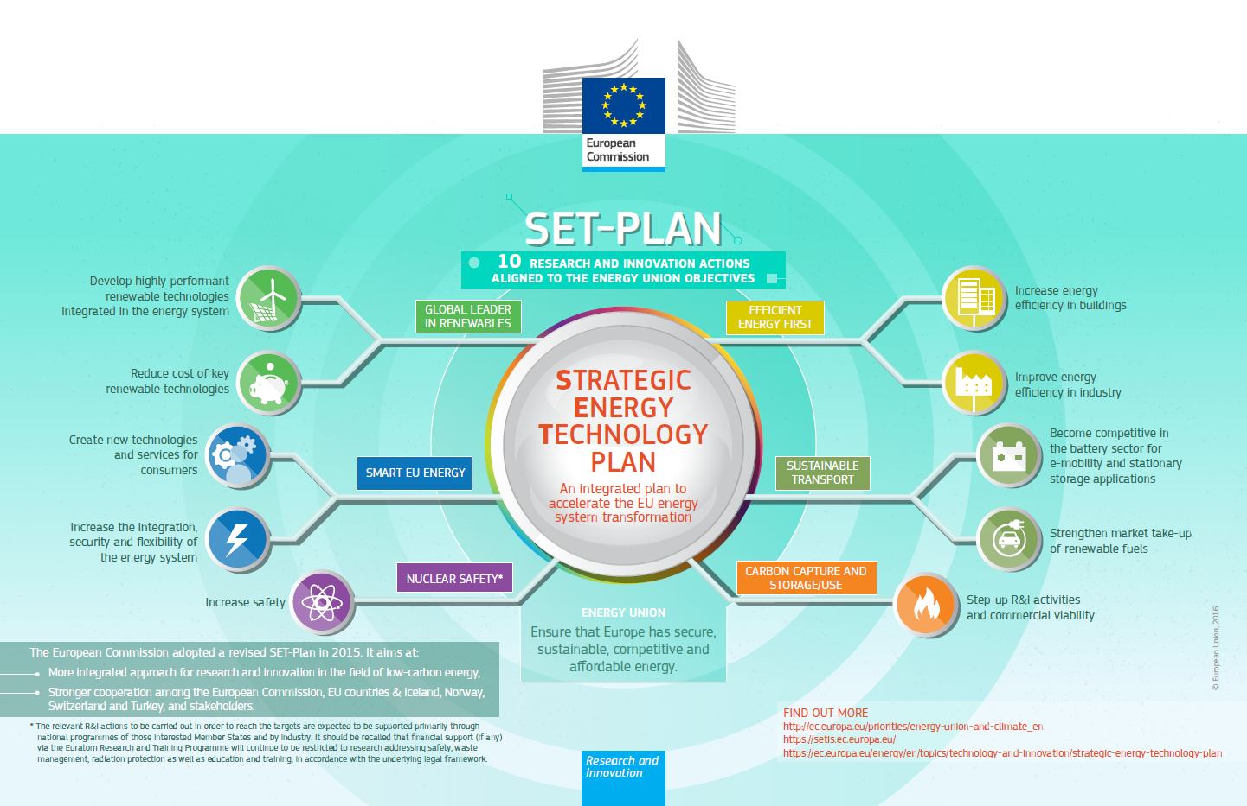

Slide 7
The Integrated SET Plan
Energy Union Strategy identified 4+2 R&I priorities to speed energy transition
  # 1 in renewable energy
  smart EU energy systems with consumers at centre
  energy efficiency first
  sustainable transport
  carbon capture and storage/use
  nuclear safety
2015 Integrated SET Plan Communication translated priorities into 10 Actions
In 2016: EC, SET Plan countries & stakeholders set R&I targets for each action
  to make technologies cost-effective & better-performing
  to place Europe at forefront of next generation low-carbon energy technologies
Renewable Energy: EU ambition to be world leader
ambitious R&I targets set for 5 renewable technologies with great potential for cost reductions, performance improvements & large-scale deployment worldwide - off-shore wind, next generation of photovoltaics (PV), ocean energy, concentrated solar power (CSP) & deep geothermal
Notes:
Strategic approach to R&I in the Energy Union Strategy and identified 6 priorities to be delivered through the Strategic Energy Technology Plan (SET Plan), with the aim to speed the energy transition. The areas covered include being # 1 in renewable energy; smart EU energy systems with consumers at the centre; energy efficiency first, sustainable transport; carbon capture and storage/use; and nuclear safety.
The 2015 SET Plan Communication proposed tackling the energy system in Europe as a whole and translated the Energy Union R&I priorities into 10 Actions. In 2016, national governments (from all the EU Member States plus Norway, Switzerland, Iceland and Turkey) as well as industry and research actors have set technology cost and performance targets through a wide participatory process.
The aim of these R&I targets is to accelerate the decarbonisation of the energy systems, by making technologies cost-effective and better-performing. Reaching these targets will place Europe at the forefront of the next generation of low-carbon energy technologies and of energy efficiency, creating economic growth, jobs and increased competitiveness. It will also positively impact on the well-being of European citizens.
The focus is put on those low-carbon technologies that have the highest innovation potential for delivering cost reductions and improvement of performance quickly, and which can contribute in this way to the decarbonisation of the European energy system. Technologies that will facilitate the integration of low-carbon technologies into the European energy system are also considered as the integration of energy systems is instrumental to the decarbonisation of energy supply and demand
Europe has the ambition to be the world number one in renewable energy. To fulfil this objective it must lead the development of the next generation of renewable technologies, but also integrate into the energy system, efficiently and cost-effectively, the energy produced from renewable sources. Accordingly, ambitious R&I targets have been set for 5 renewable technologies with great potential for cost-reductions, performance improvements and large-scale deployment worldwide – off-shore wind, the next generation of photovoltaics (PVs), ocean, concentrated solar power (CSP) and deep geothermal.

Slide 8
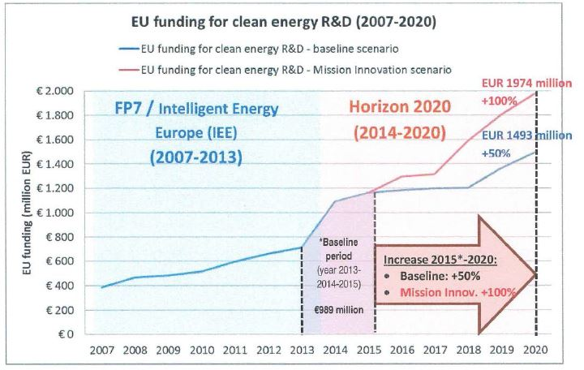
EC Doubling Investment Overview
Mission Innovation
Notes:
Launch of Mission Innovation at COP21. The EC, on behalf of the EU, is a member since June 2016. By joining other European countries (UK, DK, FR, DE, IT, SE, NL, FI in addition to Norway) allow us to collectively accelerate transition of our energy systems, to face the climate challenge.
Mission Innovation committed to doubling public clean energy RD&D investment over five years, reaching around a combined $30 billion per year by 2021. The EU is bringing a significant additional budget to the table thanks to its Research and Innovation programme, Horizon 2020. Our annual investment in clean energy R&D is set to double from around EUR 960 million to almost EUR 2 billion between 2015 and 2020, with the average annual budget over the period 2013 to 2015 taken as a baseline.
This investment is also dedicated to scaling-up international cooperation on clean energy research and development, also in terms of joint research based on mutual benefit. It is therefore crucial to better align our efforts, if we want to maximise the impact of this doubling of investment.
Importantly, the pledges to doubling investment are not possible without the engagement of the private sector which investment represents over 80% of the total capital in clean energy R&I.

Slide 9
Mission Innovation
Mission Innovation Challenges
Smart Grids (India)
Off Grid Access to Electricity (France)
Carbon Capture (US)
Sustainable Biofuels (Canada)
Converting Sunlight (EC: lead)
Clean Energy Materials (Mexico)
Affordable Heating and Cooling of Buildings (UK: lead, EC: co-lead)
Notes:
- Five years is a relatively short time frame in which we must deliver tangible results and for this reason the close collaboration among Mission Innovation members is critical. At COP22, Mission Innovation announced seven Innovation Challenges. These Challenges are our mutually agreed priorities in clean energy R&I where the increased engagement from the global research community, industry and investors is expected.
The EC will co-lead two Mission Innovation Challenges, one on converting sunlight into storable fuel and second on heating and cooling, which are ones of the EU's top energy priorities. Hereof, we would welcome all EU Member States to join us in tackling these challenges.

