Slide 1
The future smart EU energy systems with the consumer at the centre
Willem Strabbing

Slide 2








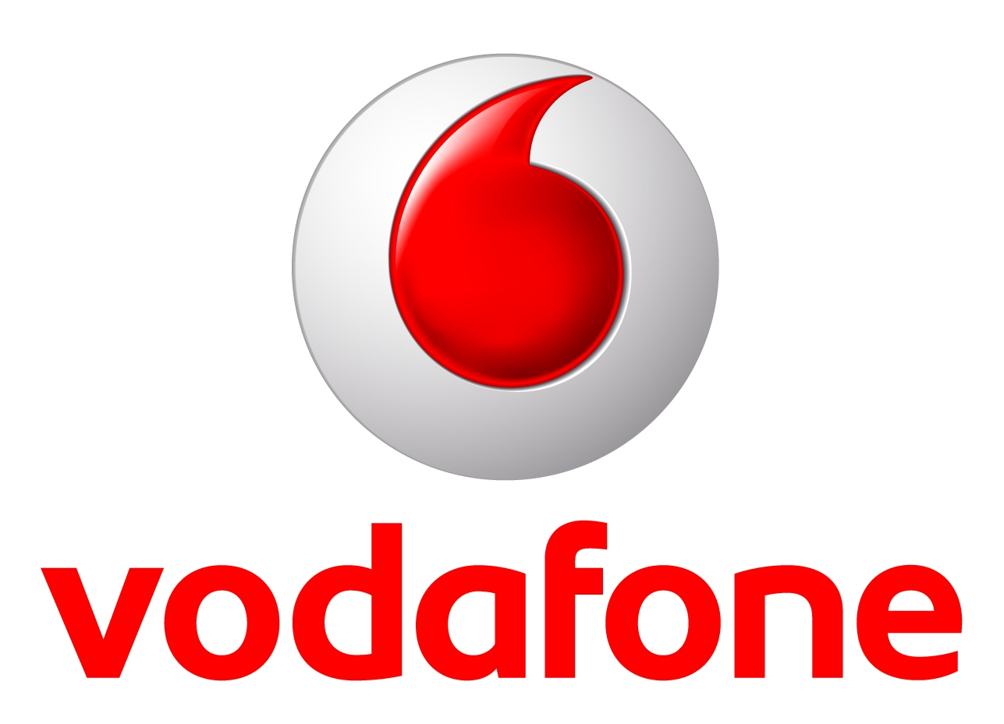





ESMIG – The European voice of smart energy solution providers

Slide 3
“Consumer at the centre”
The consumer wants
        to save money
        to have privacy, trust
        to have comfort
The consumer needs
        access to information and dynamic tariffs
        his data to be protected (proven)
        automated energy management

Slide 4
A Smart Meter is not sufficient
The Smart Meter offers interfaces, BUT
Additional tools and services are needed
        (Near) real time feedback offers best results in savings
        Portals and Apps
Data has to be protected
        Data Protect Impact Analysis by Meter Data Operator
        Privacy and security solutions implemented and up-to-date
        Consumer Energy Management is the next step
        Demand Side Flexibility
        Aggregation

