Slide 1

CLEAN ENERGY FOR ALL EUROPEANS
Newest Package for the Energy Union

Slide 2
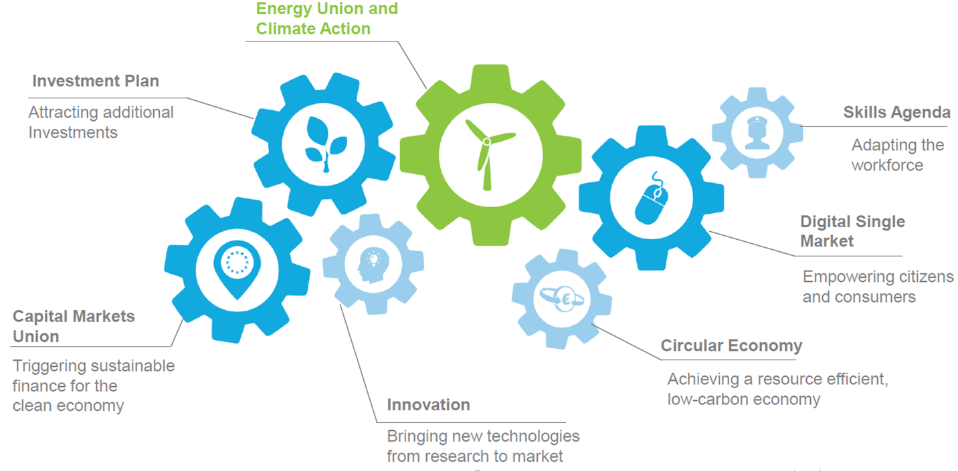
Role of the Energy Union and Climate Action in Modernizing the Economy
2

Slide 3
Dramatic Progress in Delivering the Energy Union
90% OF NEEDED PROPOSALS ARE NOW DELIVERED
PROPOSALS SUBMITTED IN LAST 20 MONTHS
√ Revision of the Regulation on security of gas supply & liquefied natural gas and storage strategy
√ Legislative proposal to revise the EU Emissions Trading System for 2021-2030
√ Legislative proposal on the Effort-Sharing Decision and the inclusion of Land Use, Land Use Change and Forestry (LULUCF) into the 2030 Climate and Energy Framework
√ Information exchange mechanism with regard to intergovernmental agreements between Member States and third countries in the field of energy
√ EU strategy for Heating and Cooling
8 LEGISLATIVE PROPOSALS DELIVERED THIS WEEK
√ Energy Union Governance Regulation
√ Recast Electricity Market Regulation
√ Recast Electricity Market Directive
√ Regulation on Risk-preparedness in the electricity sector
√ Recast Directive on the promotion of the use of energy from renewable sources
√ Recast Energy Efficiency Directive
√ Recast Energy Performance of Buildings Directive
√ Recast Regulation establishing ACER

Slide 4




Goals of the New Package
CREATING JOBS & GROWTH, BRINGING DOWN GREENHOUSE GAS EMISSIONS, SECURING ENERGY SUPPLY
  Putting energy efficiency first
  Delivering a fair deal for consumers
  Demonstrating global leadership in renewables
4
Notes:
Opportunities
Jobs and growth
The energy sector alone employs close to 2.2 million people, spread over 90 thousand enterprises across Europe.
The package has the potential to deliver up to 900,000 additional jobs and €190 billion in GDP gains by 2030
Global clean energy transition:
Translate climate ambition into concrete climate actions
EU firms and technologies to secure a leading role in global clean energy transition
Energy security:
Fossil fuel import bill savings up to €290 billion for the 2021-2030 period compared to business as usual conditions
Internal energy market to support diversification of import sources
Consumers
Share of energy spending in low-income households spendings is 9%.
Energy efficiency measures to bring significant energy savings for all consumers
Energy consumers to become prosumers, to choose when and how to satisfy their energy needs
Challenges
Energy Efficiency
Need to increase rate and depth of buildings' renovation, from current 1% annual rate
EU firms and technologies to continue leading the race towards energy innovation
Renewables
EU firms and technologies to continue leading the race towards energy innovation
Electriticy markets to be made fit for renewables, and renewables fit for the markets
Deal for Consumers
Provide consumers with necessary tools to make them benefit from the energy transition: access to information, recognition of energy communities role, access to smart technologies
Ensure coherence and adequacy of policy action at various levels

Slide 5
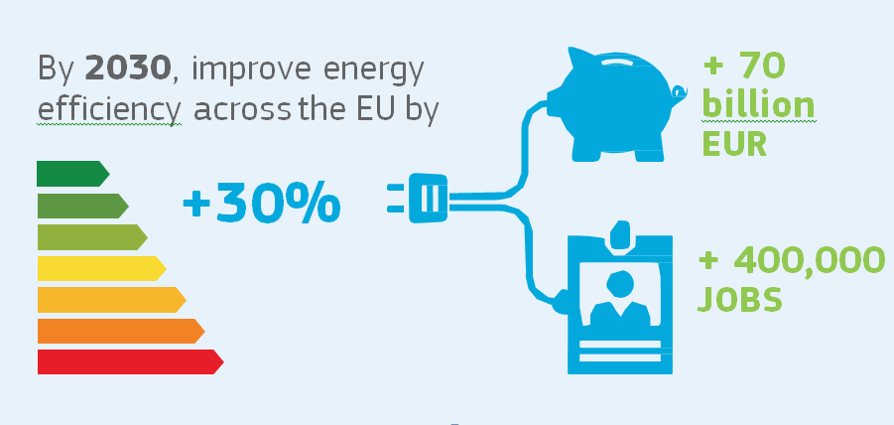
Energy Efficiency Sector Generates Jobs and Money

Slide 6
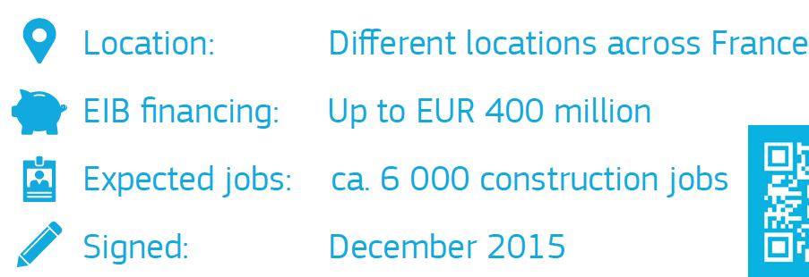
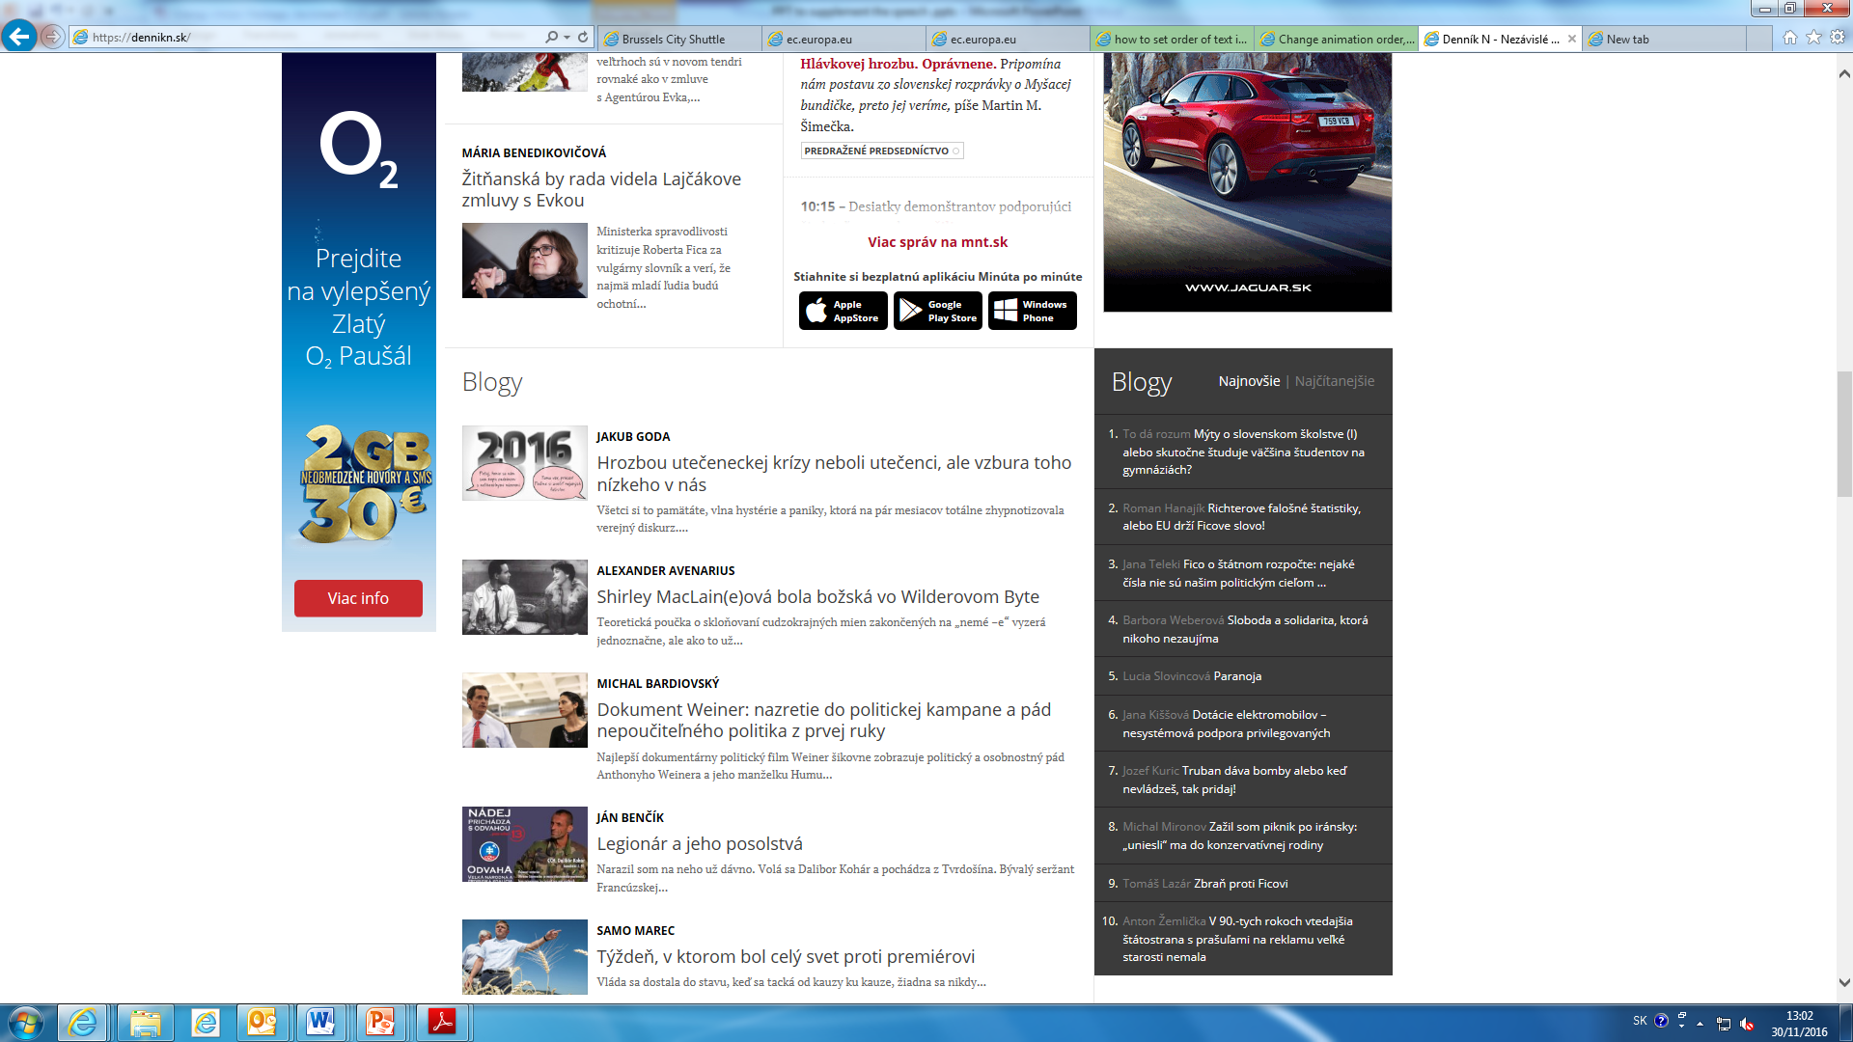
Energy Efficiency in Residential Buildings in France
Increasing energy efficiency of 40,000 flats and houses by improving their insulation and renovating the heating and ventilation systems.
In long term save the energy consumption roughly equivalent to 9,600 households.
6

Slide 7
Main Elements of the Energy Union Governance
National Integrated Energy and Climate Plans (2021 to 2030)
National Progress Reports (every 2 years)
European Commission monitoring
7

Slide 8
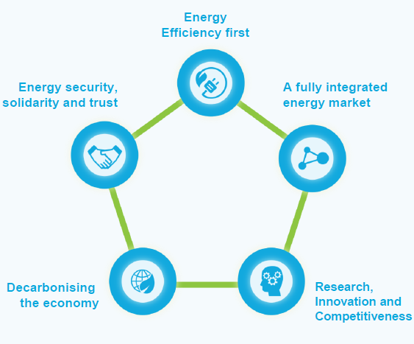
AN ENERGY UNION BASED ON 5 MUTUALLY SUPPORTIVE AND INTERLINKED DIMENSIONS
8

Slide 9

9 #EnergyUnion

